Slide 1


MY PORTFOLIO

Slide 2
SUMMARY
This portfolio website is designed to showcase My skills, projects, and contact details.
It includes a navigation bar, a hero section with a typing animation in home page.
An about section, a skills showcase, and a project gallery highlighting AI-driven storytelling, a dynamic form builder, and face recognition.
The contact section provides an email, phone number, location, and social media links.
Built using HTML, CSS and JavaScript, the site is visually appealing and responsive. It also features a downloadable CV and a hire me button for easy interaction. The site ensures a professional and engaging online presence.

Slide 3
CODE HIGHLIGHTS

Slide 4
NAVIGATION BAR
1
CODE
<header class="header">
<nav class="nav container">
<a class="nav__logo">VARSHA</a>
<ul class="nav__list">
<li class="nav__item"><a href="#home" class="nav__link active-link">HOME</a></li>
<li class="nav__item"><a href="#about" class="nav__link active-link">ABOUT</a></li>
<li class="nav__item"><a href="#skill" class="nav__link active-link">SKILL</a></li>
<li class="nav__item"><a href="#project" class="nav__link active-link">PROJECT</a></li>
<li class="nav__item"><a href="#contact" class="nav__link active-link">CONTACT</a></li>
</ul>
</nav>
</header>
EXPLANATION
This is the navigation bar that allows users to scroll through different sections.
Uses CSS for styling and anchors for smooth scrolling

Slide 5
HEROIC SECTION
2
CODE
<section class="hero" id="home">
<div class="content">
<h3>Hello everyone</h3>
<h1>I'm VARSHA S</h1>
<h3><span class="typing"></span></h3>
<a href="VarshaS_Resume.pdf" class="btn">Download CV</a>
<a href="file:///C:/Users/Varsha%20S/OneDrive/Desktop/Inter%20project/form.html" class="btn">Hire Me</a>
</div>
</section>
EXPLANATION
Displays name and a dynamic typing effect using the script.js library.
Includes buttons to download the resume and navigate to a contact form

Slide 6
CONTACT FORM
3
CODE
<form action="https://api.web3forms.com/submit" method="POST">
<input type="hidden" name="access_key" value="YOUR_ACCESS_KEY">
<input type="text" name="name" placeholder="Your Name">
<input type="email" name="email" placeholder="Your Email">
<textarea name="message" placeholder="Your Message"></textarea>
<button type="submit">Submit</button>
</form>
EXPLANATION
Uses Web3Forms API to submit contact form data without a backend.
Includes fields for name, email, and message.

Slide 7
How the Project Works

Slide 8
Navigation:
Users can easily navigate between sections using the navigation menu.
Smooth scrolling effect for better user experience.
Home Page:
Displays name, introduction, and typing animation.
“Download CV” button allows users to get a PDF resume.
About Section:
Describes skills, experience, and background.
Skills Section:
Displays technical skills in an interactive card format. (HTML, CSS, JAVA, C, Mysql)
Projects Section:
Lists three major projects:
AI-Driven Visual Storytelling
Dynamic Form Builder
Face Recognition
Contact Section:
Users can fill out a contact form powered by Web3Forms API.
Displays email, phone number, LinkedIn, GitHub, and location.

Slide 9
TOOLS & TECHNOLOGIES USED

Slide 10
Category | Tools / Technologies Used
Frontend | HTML, CSS, JavaScript
Styling | CSS, Flexbox, Grid
Icons | Font Awesome
Typing Effect | Typed.js Library
Form Handling | Web3Forms API
Animations | CSS Transitions, Hover Effects
Maps | Google Maps (Location Link)
Version Control | GitHub

Slide 11
RESULTS & OUTPUT

Slide 12
Home Page with Typing Animation:
Description: The landing page welcomes visitors with an introduction and animated text effect.
Screenshot: Show homepage with "I'm VARSHA S" and animated typing effect.
Skills Section:
Description: Displays the technical skills in numbered cards. Screenshot: Show skill cards (HTML, CSS, SQL, Java, C, etc.)
Projects Section:
Description: Showcases major projects with brief descriptions.
Screenshot: Display project cards with project titles & descriptions.
Contact Section with Form Submission:
Description: Allows users to fill out a form to contact you. Screenshot: Show contact form fields and social media links.

Slide 13
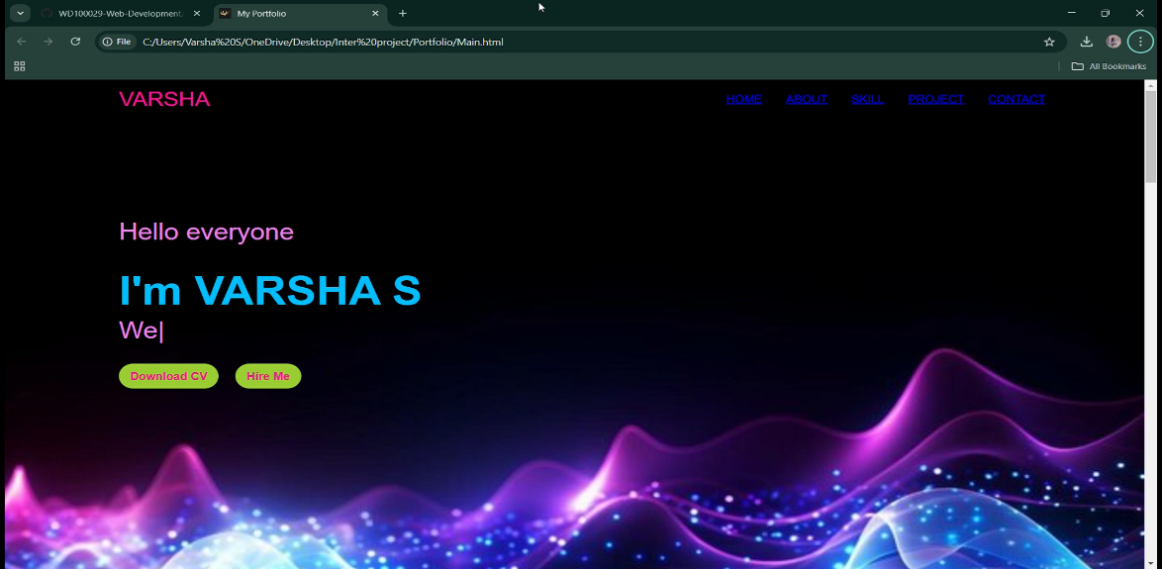
HOME PAGE

Slide 14
THANK YOU

